Slide 1
Use the same title you
used in the report
Title used in the report
Name of the first student
Name of the second student
Medellín, Date of the oral presentation
Write your names and
the date of the oral presentation

Slide 2
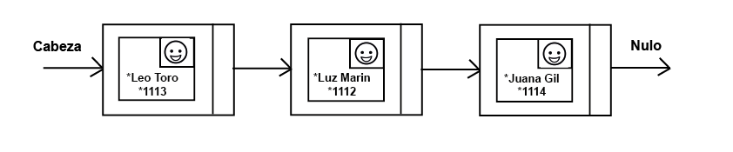
Keep this title
Data Structures
Use vectorized figures to
explain the data structures you designed
Figure 1: Simply linked list of persons. One person is a class that contains name, id and picture.
Explain the figures in your
own words

Slide 3
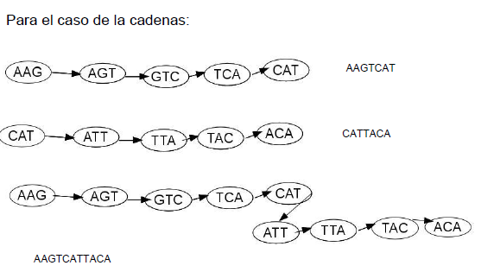
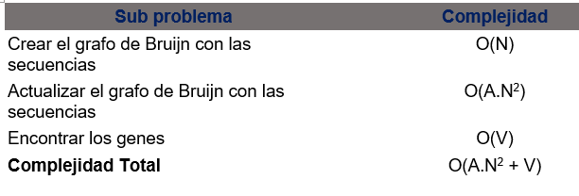
Algorithm and Complexity
Keep this title
Figure 2: Assembly of DNA fragments obtained from a DNA sequencer.
Table 1: Time complexity of the algorithm in the worst case, best case and average case.
Include your own figures and explanations

Slide 4
Algorithm design criteria
Keep this title
After analyzing several posible solutions to the problema, we conclude
that a solution based on De Bruijn graphs is a good solution for the
problem of assembly a DNA sequence if we use De Bruijn’ s approach
in such a way that the number of k-mers is not an input of the algorithm.
To find out the genes in a DNA string, we use Boyer-Moore algorithm
because the algorithm is efficient to find patterns in a string when the
alphabet size is small.
Include your own figures and
explanations

Slide 5
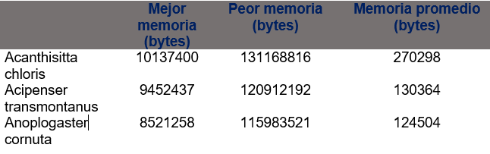
Time and Memory Consumption
Keep this title
Figure 3: Memory consumption of a DNA assembly algorithm based on De Bruijn graph tested with mitochondrial DNA samples of 3 vertebrates.
Include your own figures and explanations

Slide 6
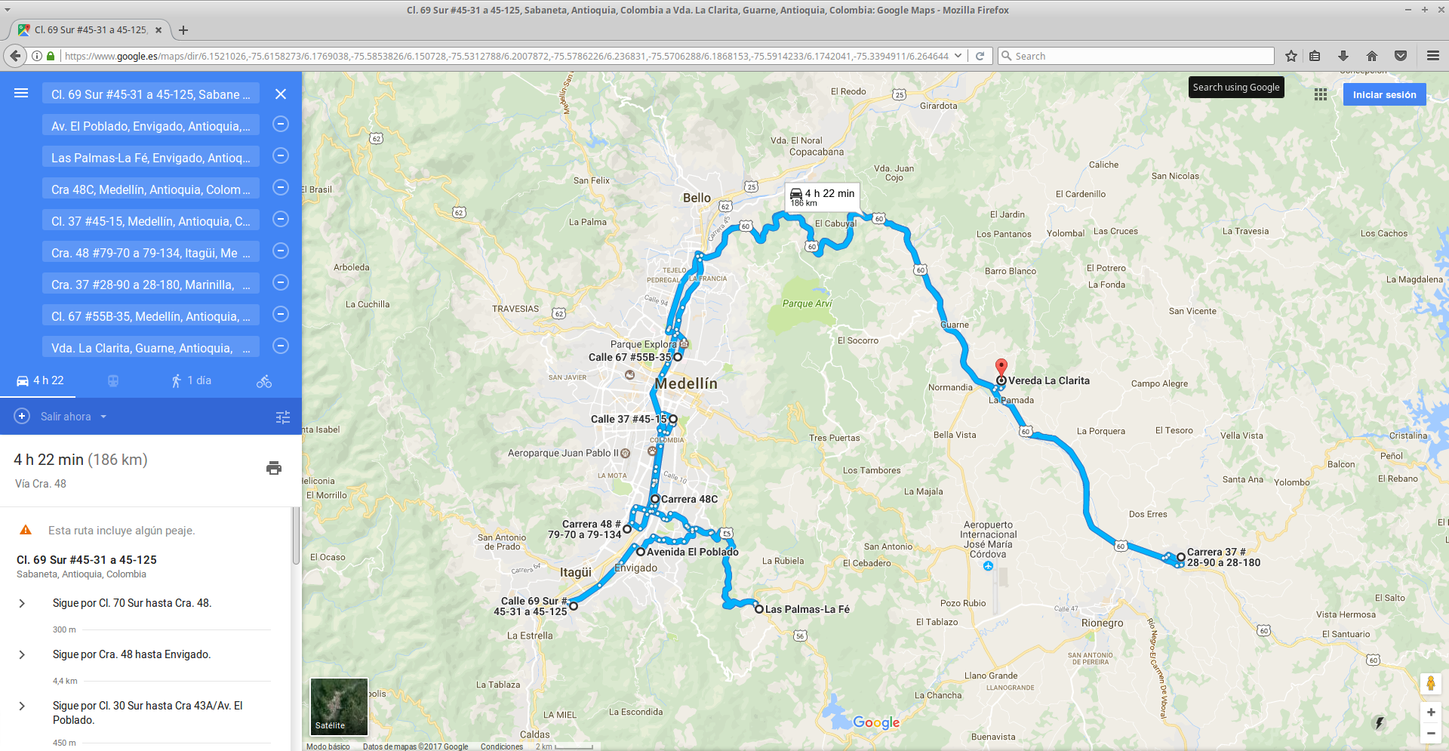
Software prototype
Keep this title
Figure 4: System of optimal delivery routing
Include your own figures

Slide 7
Report accepted in arXiv
Keep this title
C. Patiño-Forero, M. Agudelo-Toro, and M. Toro. Planning system for deliveries in Medellín. ArXiv e-prints, Nov. 2016. Available at: https://arxiv.org/abs/1611.04156
Include the link of your
report in arXiv

